Slide 1
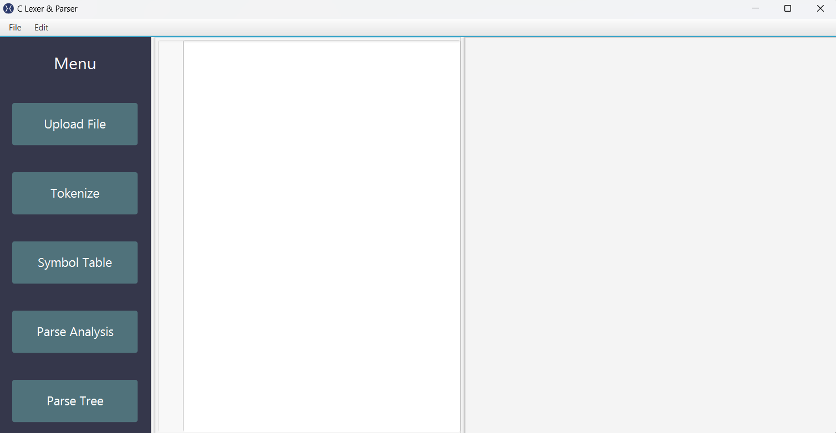

CSE439
Design of Compilers
Presented to: Dr. Wafaa Samy Eng. Ahmed Salama

Slide 2


Team 20
Ahmed Nezar
21P0025
Omar Alaa
21P0197
Kirollos Ehab
21P0006
AbdulRahman Hesham
21P0153
Tsneam Ahmed
21P0284

Slide 3

Timeline
Introduction
01
Lexer
02
Symbol Table
03
Parser
04
Grammer Rules
05
Parse Table
06
Parse Tree
07
Conclusion
08

Slide 4



01
Introduction
Goal
What is a Compiler?
Resources
Our goal was to create a compiler using lexer & parser for C language
A compiler is a software tool that translates source code written in a high-level programming language into machine code or bytecode that can be understood and executed by a computer's processor.
C language reference, Tutorials, Lectures & Compilers: Principles, Techniques, and Tools

Slide 5
Timeline
Introduction
01
Lexer
02
Symbol Table
03
Parser
04
Grammer Rules
05
Parse Table
06
Parse Tree
07
Conclusion
08

Slide 6

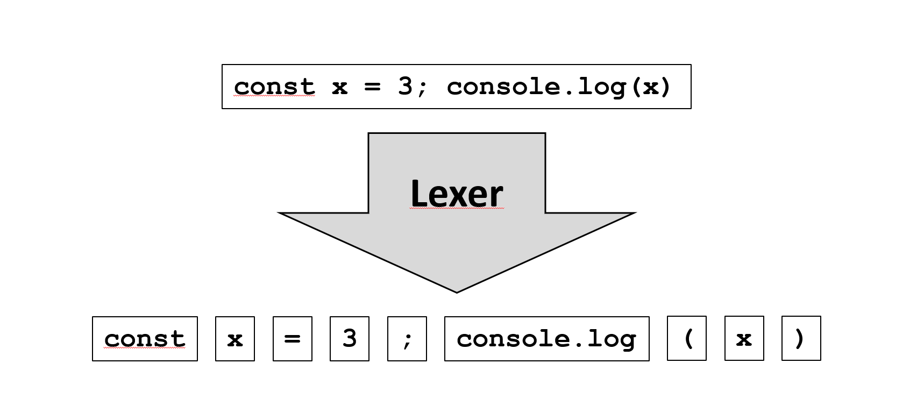
02
Lexer
01
Introduction to Lexer
02
Functionality of Lexer
03
Implementation of Lexers

Slide 7
01
Introduction to Lexer
a
A lexer (lexical analyzer) is the first phase of a compiler
b
Lexers play a crucial role in the compilation process
c
Breaks down code to tokens using regular expressions

Slide 8
02
Lexer
01
Introduction to Lexer
02
Functionality of Lexer
03
Implementation of Lexers

Slide 9
02
Functionality of Lexer
a
Lexers analyze the source group them into tokens based on predefined rules
b
Different types of tokens represent keywords, identifiers, literals, operators, and punctuation.
c
Lexers detect and report lexical errors, such as invalid characters or unrecognized symbols.

Slide 10
02
Lexer
01
Introduction to Lexer
02
Functionality of Lexer
03
Implementation of Lexers

Slide 11
03
Implementation of Lexers
a
Lexers often utilize regular expressions to define patterns for recognizing tokens.
b
Lexers can be implemented using FSMs to efficiently transition between different states
c
Lexers may employ data structures like queues or stacks to manage tokens during the tokenization process.

Slide 12
Timeline
Introduction
01
Lexer
02
Symbol Table
03
Parser
04
Grammer Rules
05
Parse Table
06
Parse Tree
07
Conclusion
08

Slide 13
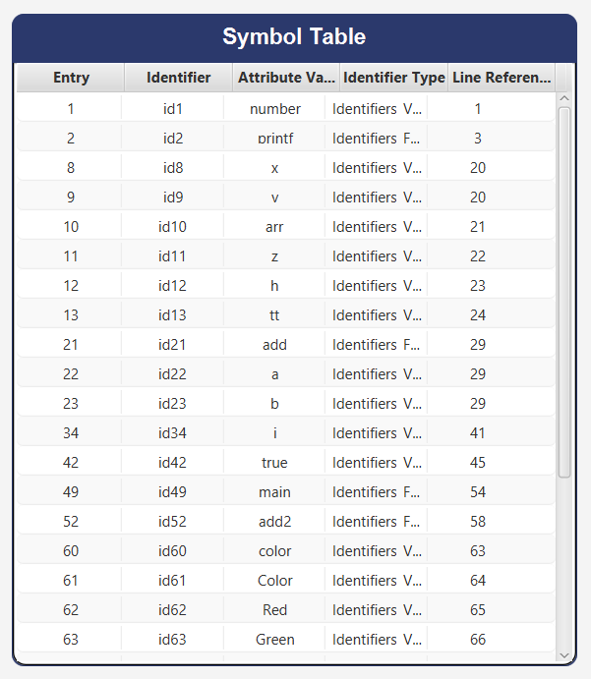
03
Symbol Table
01
Introduction to Symbol Tables
02
Functionality of Symbol Tables
03
Symbol Attributes

Slide 14
03
Symbol Table
01
Introduction to Symbol Tables
02
Functionality of Symbol Tables
03
Symbol Attributes

Slide 15
03
Symbol Table
01
Introduction to Symbol Tables
02
Functionality of Symbol Tables
03
Symbol Attributes

Slide 16
Timeline
Introduction
01
Lexer
02
Symbol Table
03
Parser
04
Grammer Rules
05
Parse Table
06
Parse Tree
07
Conclusion
08

Slide 17
04
Parser
01
Introduction to Parsers
02
Functionality of Parsers
03
Types of Parsers

Slide 18
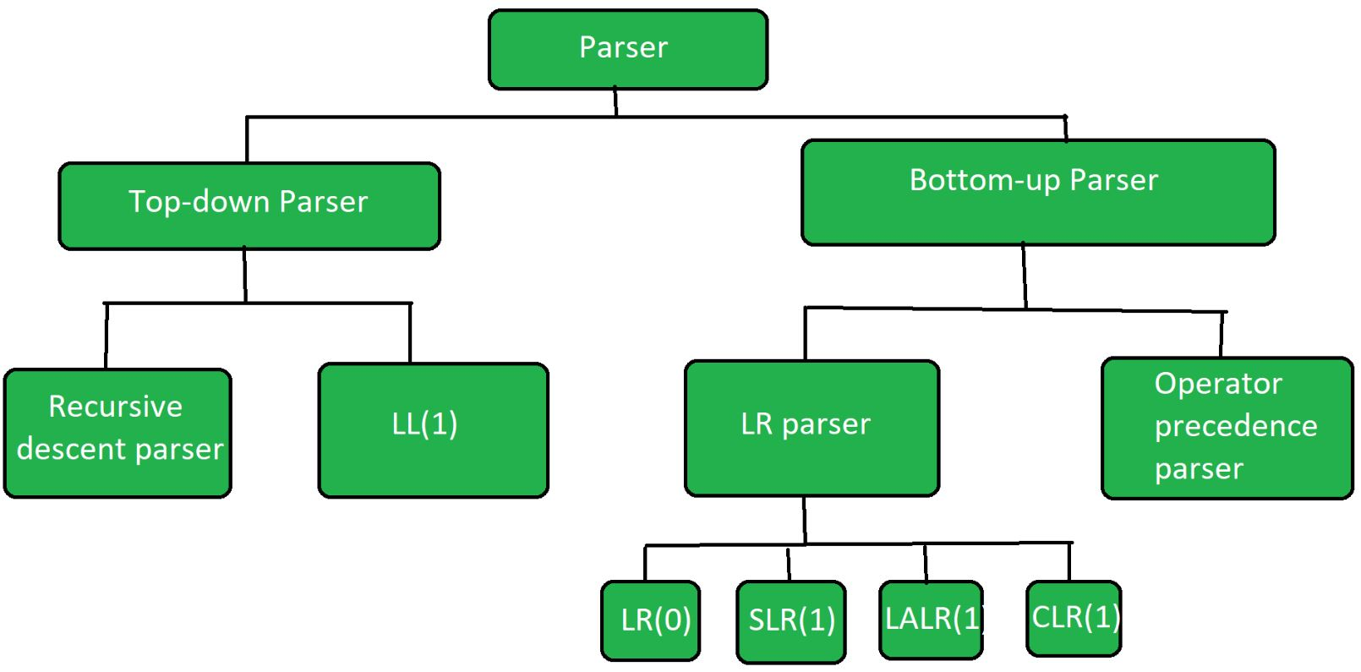
03
Types of Parsers
a
Top-Down Parsing
b
Bottom-Up Parsing

Slide 19
03
Types of Parsers
a
Top-Down Parsing
b
Bottom-Up Parsing

Slide 20
03
Types of Parsers
a
Top-Down Parsing
b
Bottom-Up Parsing

Slide 21
Timeline
Introduction
01
Lexer
02
Symbol Table
03
Parser
04
Grammer Rules
05
Parse Table
06
Parse Tree
07
Conclusion
08

Slide 22
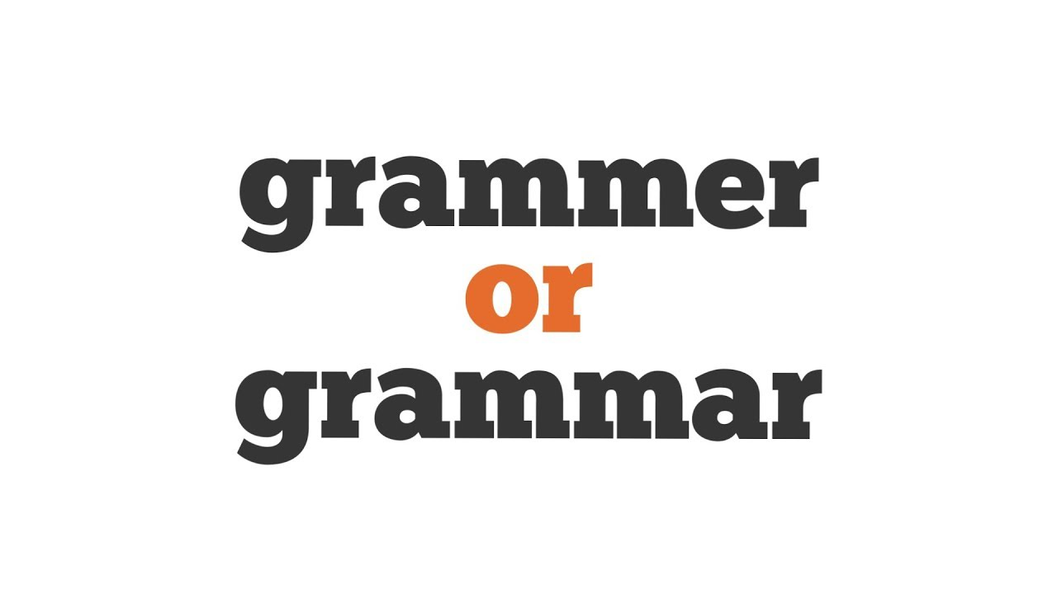
05
Grammer Rules
01
Introduction to Grammar Rules
02
Components of Grammar Rules
03
Types of Grammar Rules

Slide 23
01
Introduction to Grammar Rules
a
Grammar rules define the syntax of a programming language or formal language.
b
Grammar rules specify the structure and organization of valid statements or expressions

Slide 24
05
Grammer Rules
01
Introduction to Grammar Rules
02
Components of Grammar Rules
03
Types of Grammar Rules

Slide 25
02
Components of Grammar Rules
a
Terminals -> symbols representing the smallest units of the language
b
Non-terminals: Symbols representing syntactic categories
c
Productions: Rules that define how non-terminals can be expanded into sequences of terminals and other non-terminals
We created 125 grammar rule

Slide 26
05
Grammer Rules
01
Introduction to Grammar Rules
02
Components of Grammar Rules
03
Types of Grammar Rules

Slide 27
03
Types of Grammar Rules
a
Context-Free Grammar (CFG)
b
Regular Grammar -> Using Regular expression
c
Extended Backus-Naur Form (EBNF)
Let’s check some of the samples we did

Slide 28
03
Types of Grammar Rules
a
Context-Free Grammar (CFG)
b
Regular Grammar -> Using Regular expression
c
Extended Backus-Naur Form (EBNF)
We can check some samples when showing the demos

Slide 29
05
Grammer Rules
01
Introduction to Grammar Rules
02
Components of Grammar Rules
03
Types of Grammar Rules

Slide 30
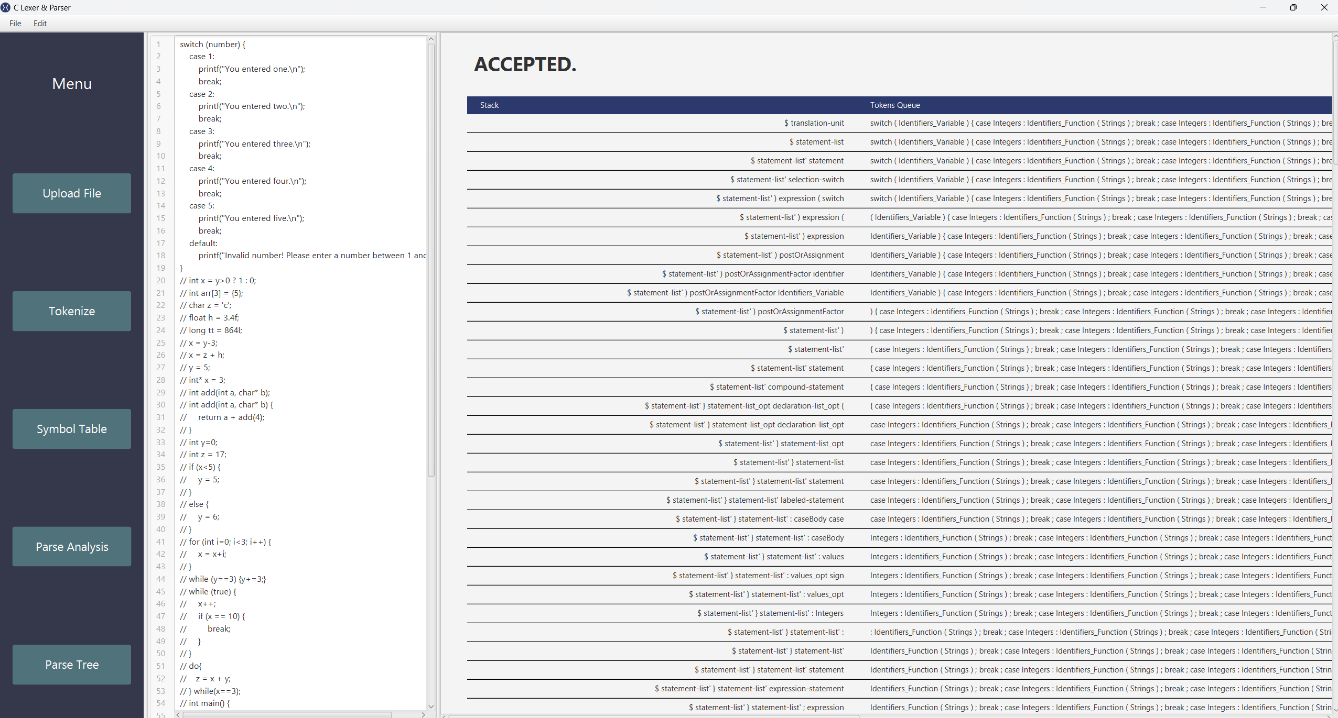
04
Parse Table
01
Algorithm to construct LL(1) Parsing Table

Slide 32
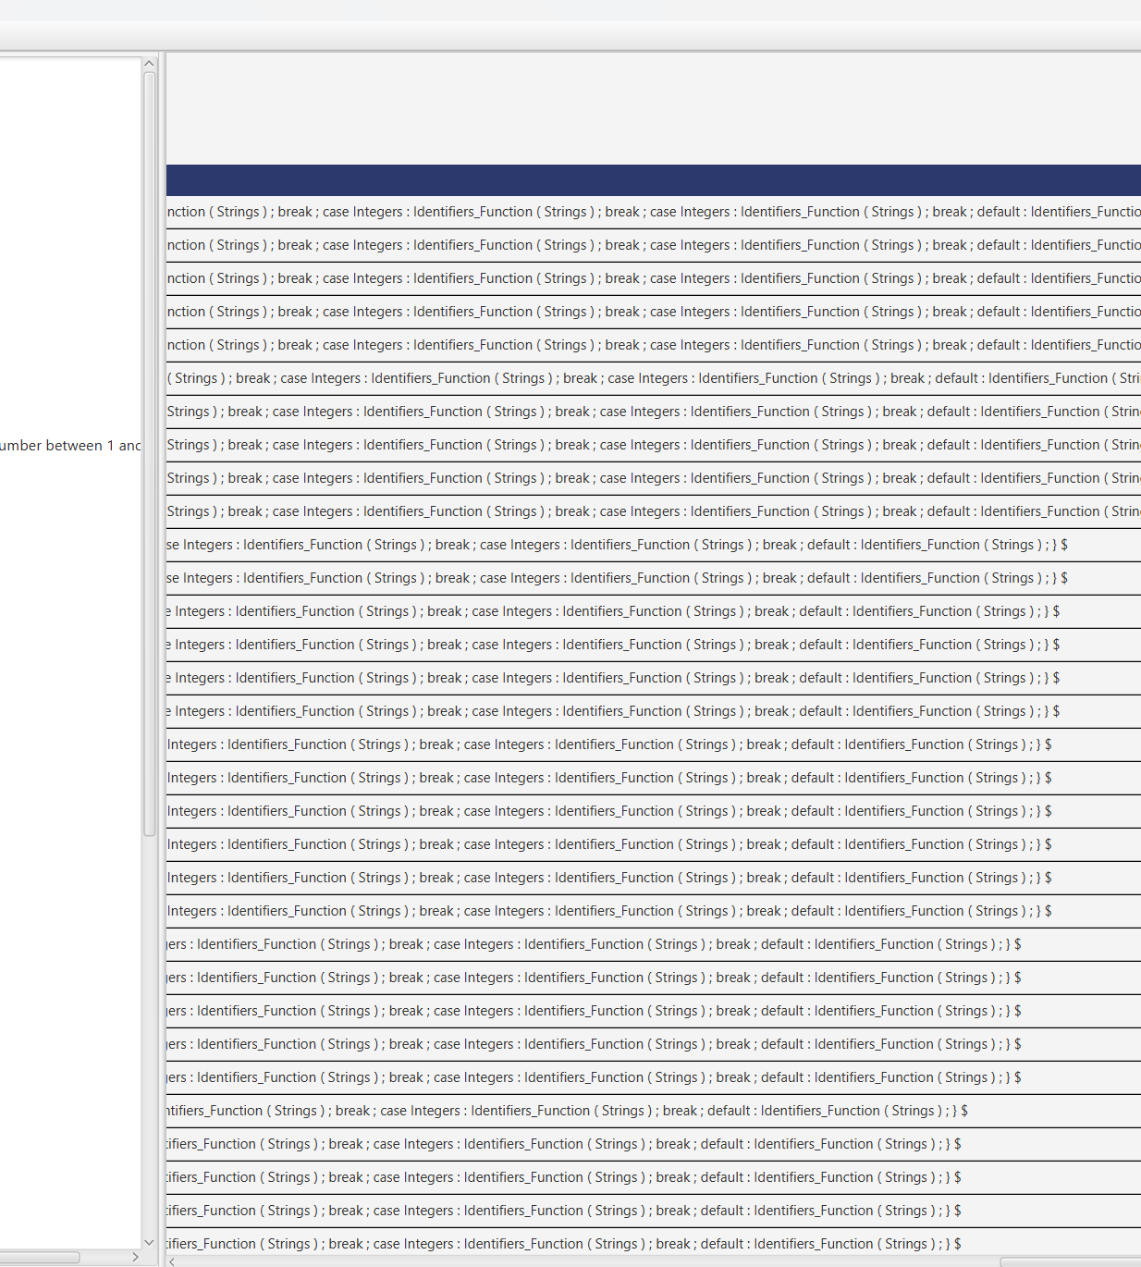

Slide 33
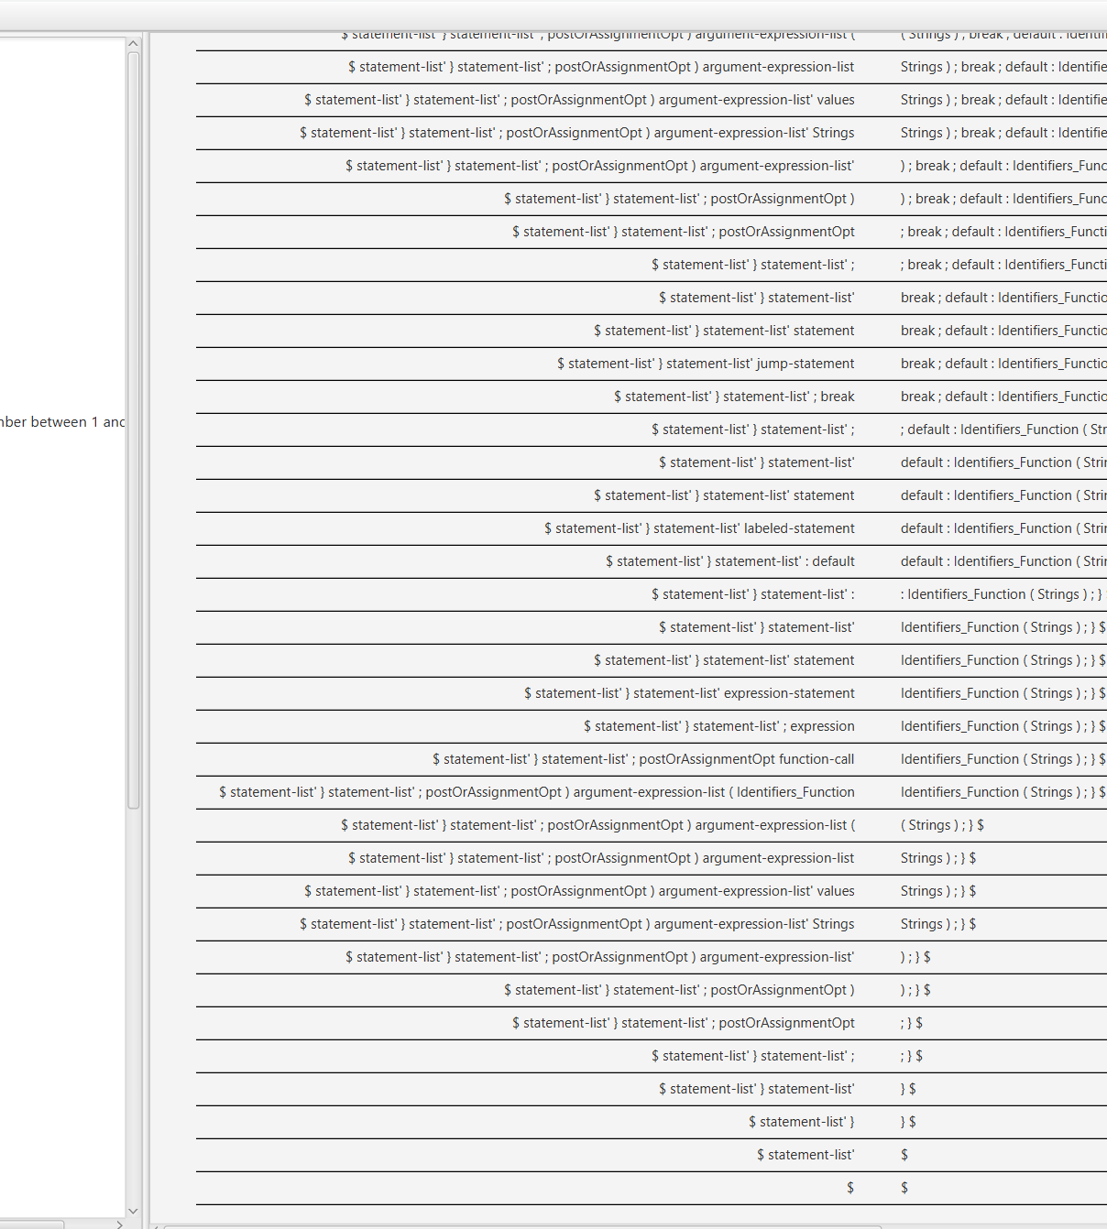

Slide 34

01
Algorithm to construct LL(1) Parsing Table
a
Step 1: First check all the essential conditions
b
Step 2: Calculate First() and Follow() for all non-terminals.
c
Step 3: For each production A –> α. (A tends to alpha)

Slide 35
a
Step 1: First check all the essential conditions
1
The grammar is free from left recursion.
2
The grammar should not be ambiguous
3
The grammar has to be left factored in so that the grammar is deterministic grammar.

Slide 36
a
Step 1: First check all the essential conditions
1
The grammar is free from left recursion.
2
The grammar should not be ambiguous
3
The grammar has to be left factored in so that the grammar is deterministic grammar.

Slide 37
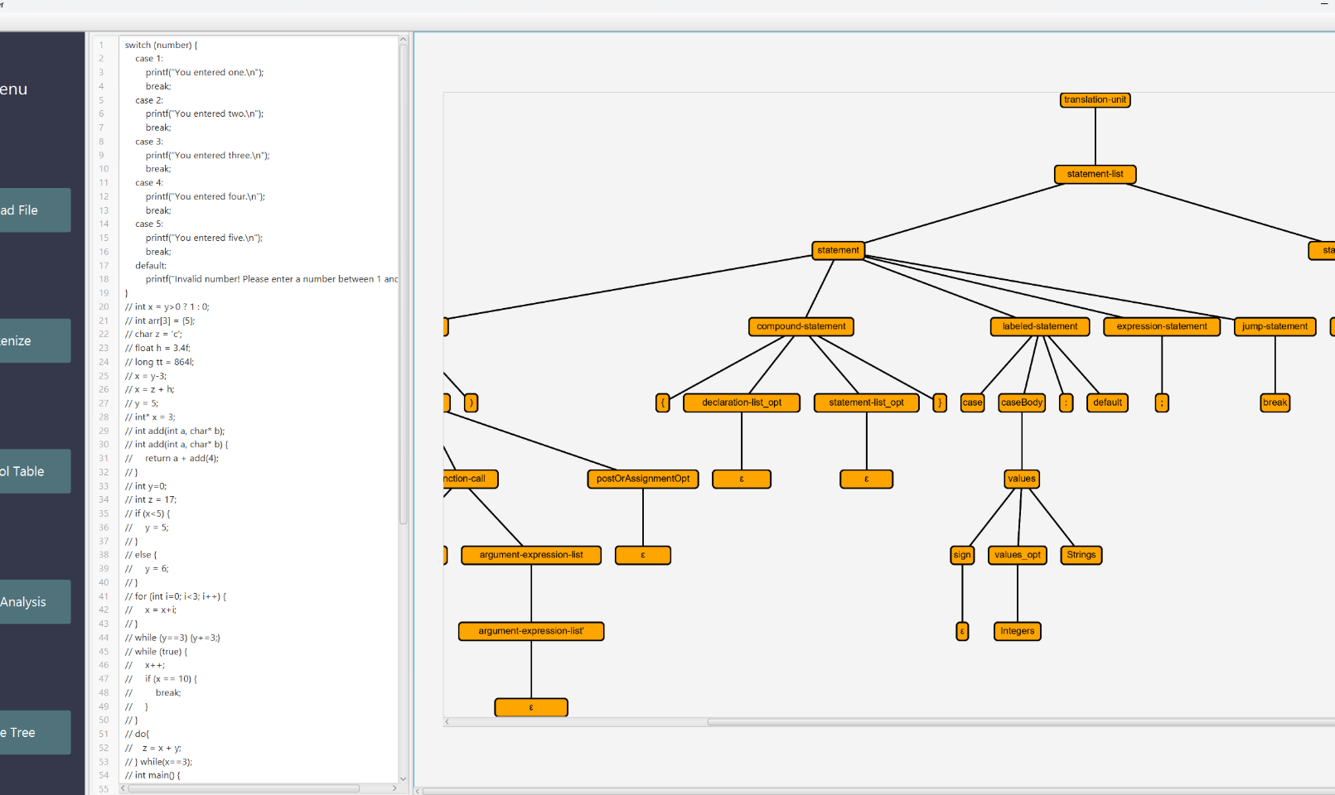

04
Parse Tree
0

Slide 38
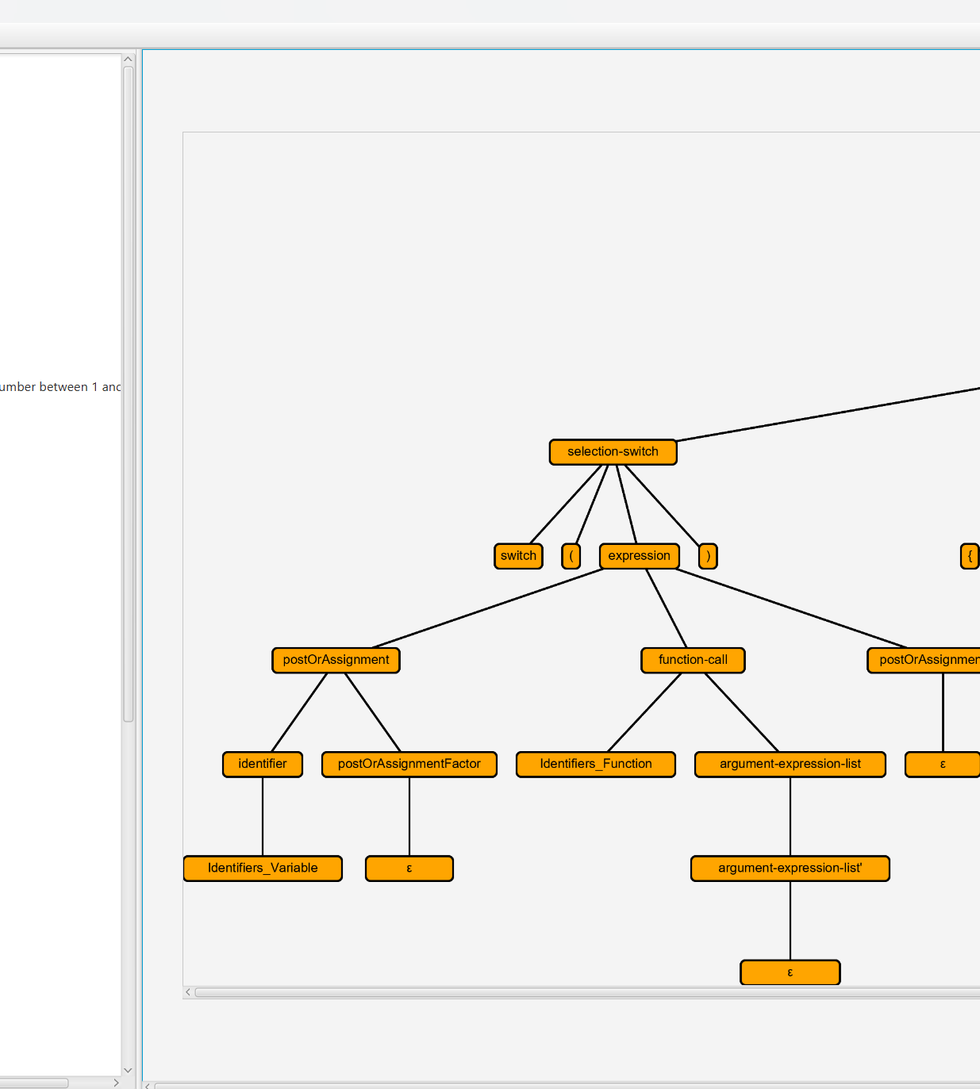

Slide 40

conclusion
Syntax analysis is a second phase of the compiler design process that comes after lexical analysis.
The syntactical analyzer helps you to apply rules to the code.
Parse checks that the input string is well-formed, and if not, reject it.
Parsing techniques are divided into two different groups: Top-Down Parsing, Bottom-Up Parsing.
A grammar is a set of structural rules which describe a language.

Slide 41

THANK YOU!

